Slide 1




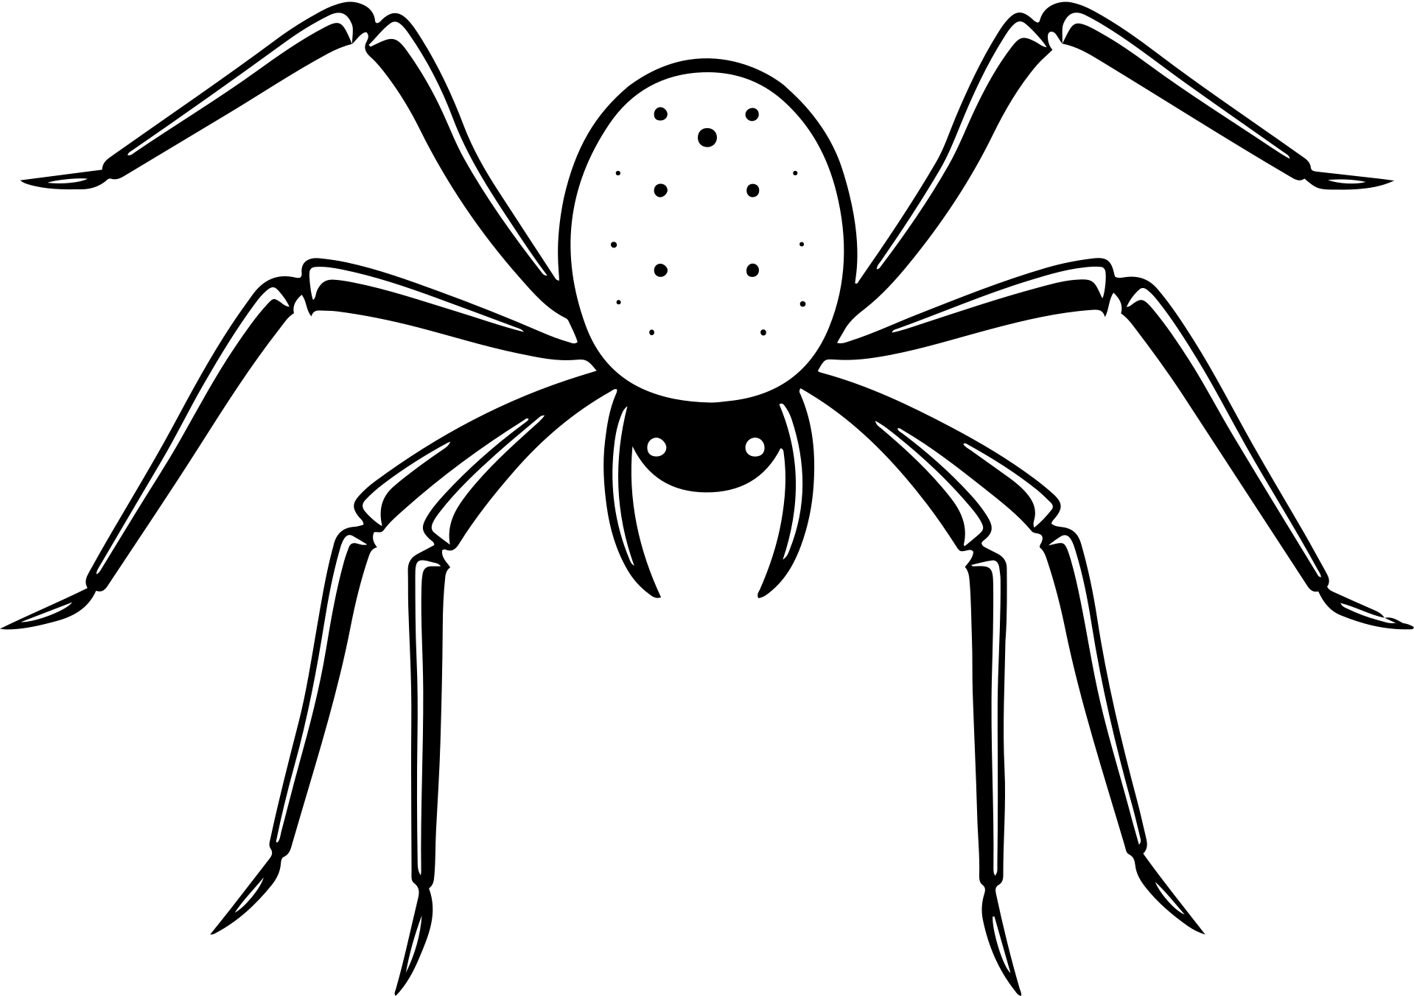





RHS SWENext
HALLOWEEN CHALLENGE

Slide 2
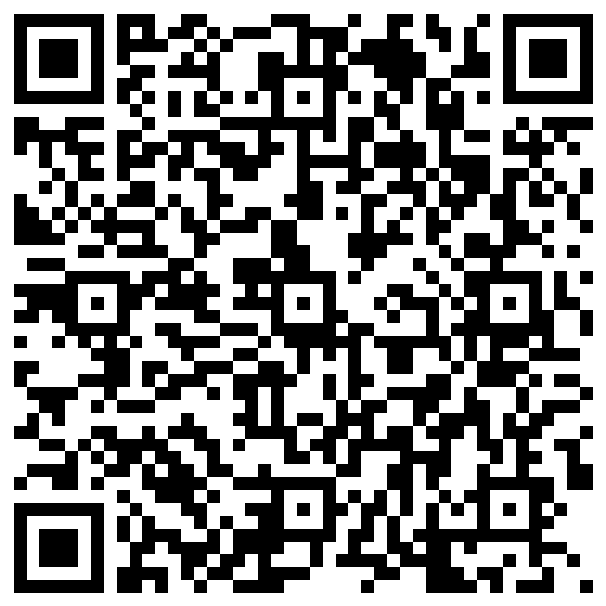


ATTENDANCE

Slide 3








MEMBER SWEEPSTAKES
Each time you invite a new member to attend a meeting/follow our instagram and join our Teams, you will fill out a form with your name + the new member’s name.
We will randomly select a winner of the sweepstakes every other month!
Prizes:
  SWENext Merch
  Gift cards
  Tech goodies
  and more!

Slide 4
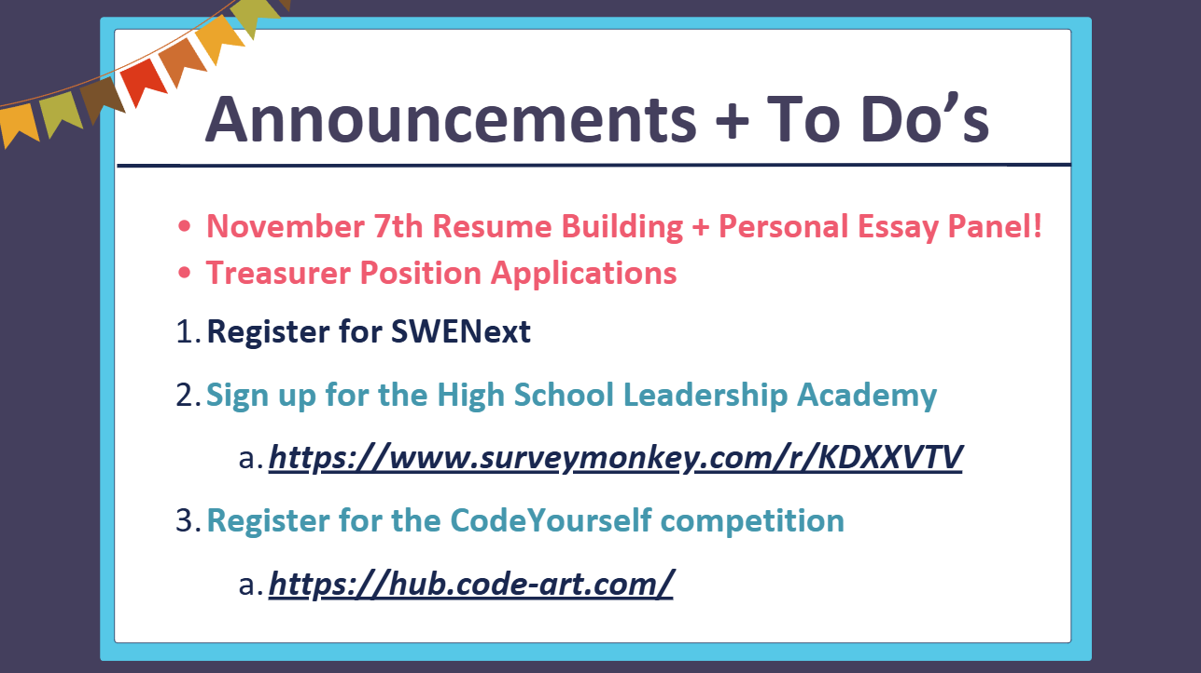

Slide 5






THE CHALLENGE

Slide 6

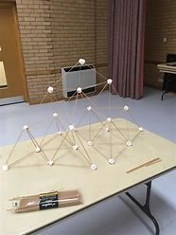
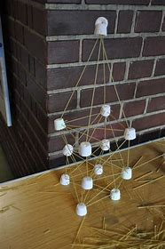
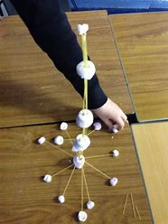
SPAGHETTI TOWER
Goal:
Build the tallest spaghetti tower that can hold a cotton ball at the top
Materials (per team):
20 strands of spaghetti
15 marshmallows
1 cotton ball
Time: 20 minutes

Slide 7

PRIZES

Slide 8









THANK YOU

